Slide 1

DriverPass System Analysis
J. F. Kiddy
Notes:
[No speaker notes required for this slide.]

Slide 2

System Requirements
Functional requirements
The system will verify and validate user credentials when logging in.
The system will have a scheduling system for scheduling the driving instructor reservations.
Nonfunctional requirements
System should perform back ups daily.
Should an attack be detected the user will be logged out and account will be locked and possible server shut down if the attack is severe.
Notes:
In order for our system to run, there are two different requirements that need to be met. The first of these requirements are the functional requirements, which means these are what exact duties and/or functions the system will carry out. However, those exact duties have to be supported by other requirements known as the non-functional requirements. As an example, in order to gain access to the system the user must have a the proper credentials. Secondly, this system must have a scheduler function in order for students to book lessons with instructors and instructors to keep track of their bookings. So other examples of functional requirements, updates with any new regulation or laws, tracking the progress of the classes and hours the user has logged and showing and tracking online test progress. For nonfunctional requirements, these are not mission essential but are still desired and/or required. In this case the system shall perform back ups daily to prevent data loss. Also, should the system come under attack, several security features would be activated depending upon how serious the attack is. Other nonfunctional requirements are notifying users of unsecure connections, after a predetermined number of failed attempts of signing in the system will inform the administration and logins pages should be secured by digital certificates before login is attempted.

Slide 3
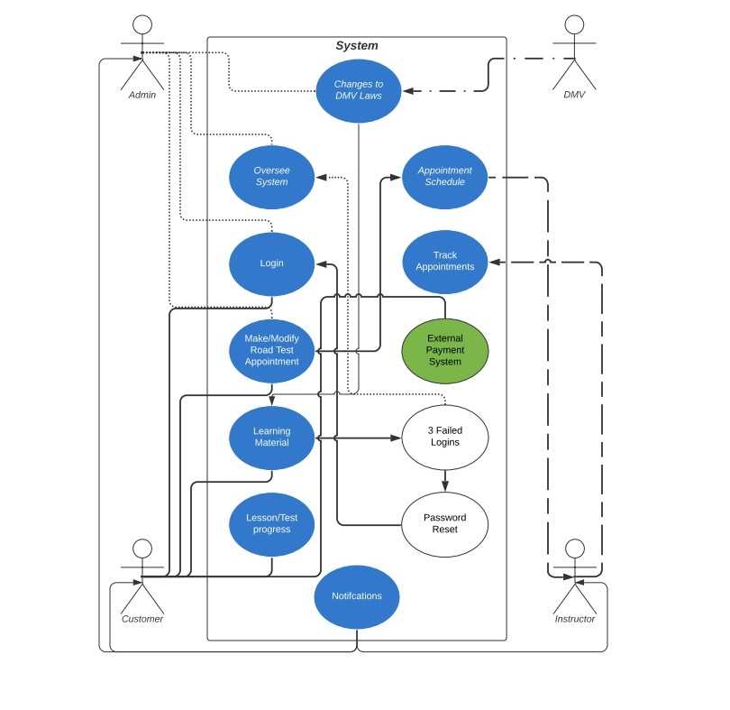
Use Case Diagram
Notes:
In this Diagram we see which users are involved in the use of the system. Starting with the DMV with suppling any and all changes to regulations/laws that effect drivers. Next is the Administrator, who is responsible for overall maintenance and health of the system and manages the entire system (resetting passwords, managing system backups, applying updates), inputting of the DMV’s changes, make changes to the appointment scheduler. The Customer, is obviously there to learn how to drive, by accessing learning material, taking tests and having road tests with an instructor. And lastly is the instructor who inputs their availability, track their schedule and receive notifications about their schedule.

Slide 4
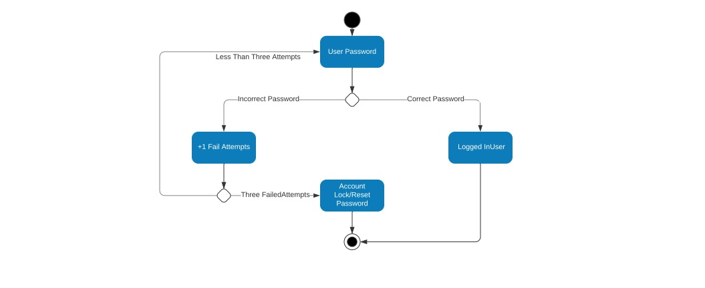
Activity Diagram
Notes:
Here is a simplistic flow of the login where the user goes to login to the application or website. Simply if the password is correct then Bob’s your Uncle. However if the user log’s in with an improper password it loops back to the user login and counts the attempts. After the third attempt the account is locked to prevent unauthorized access and the user will have to reset the password.

Slide 5
Security
System should perform back ups daily
Web Browser logins pages should be secured by digital certificates before login is attempted.
Logins will be accomplished with user specific usernames and case-sensitive passwords.
Possible use of two factor authentication. (email/text of a code for user to enter)
After a predetermined number of failed attempts of signing in the system will inform the administration, answer security questions and request a password reset sent through users stored email.
Notify user of unsecure connections.
Notify IT Administration of suspicious or unusual activity. (account hacked, brute force attacks)
Should an attack be detected the user will be logged out and account will be locked and possible server shut down if the attack is severe.
Notes:
Firstly the system should be set to perform back ups, preferably daily, which is for obvious reason. A Digital Certificate is an electronic "password" that allows a person, organization to exchange data securely over the Internet using the public key infrastructure (PKI). These Digital Certificates are verified by a trusted third party to ensure that fake or improper certificates are not used to legitimately or illegitimately gain access and should those certs fail, the system should notify the user that they are unsecured which then they should seek to remedy this problem. Using a username and password will be required from the user in order to login and Two Factor Authentication could be implemented so that after the user logs in a user receives a code via text or email to input into the system. Next as we showed in the previous slide, after a predetermined amount of failed logins the system would take action, requesting security verification and notifying the admins. Also the system should notify admins of suspicious or unusual activity such as account hacked, brute force attacks and the user account responsible and possible server shut down if the attack is severe enough to prevent any data loss or theft. The intention of these measures are to ensure that only authorized users access the system.

Slide 6
System Limitations
Mobile Platforms typically have less processing power than traditional PC’s so software will have to be optimized across platforms.
Screen size of Mobile Platforms is typically smaller than traditional PC’s so displays will have to be optimized across platforms.
Budget and Timeline do not account for any unforeseen setbacks, without this buffer project can fall behind schedule on over budget.
Notes:
As more and more people use mobile platforms, cellphones and tablets, as we build this software we must understand that not everyone is running powerful supercomputers. So designing software that works efficiently with slower computers and mobile platforms helps to ensure cross platform optimization so that DriverPass can run on your smart phone, tablet or average computer. Also again a constraint of the mobile platforms is screen size, cell phone screens are much smaller than a tablet or computer screen, and computer screens themselves come in a wide array of sizes and resolutions, much like TV’s today. Lastly and most importantly is budget concerns and limitations. Frankly with a compressed timeline the time schedule for the set up only five months. Therefore, in order to meet the time table we would need to hire more employees to build the system, which requires more money. And if a “just enough” budget is provided, should any setbacks crop up, this can affect the final product, whether certain functions are left out, or the problems are mitigated as best as possible and the system is rolled out regardless. Either of this are undesirable as limited functionality can hinder the user or if the problem is left emplace it could be a security risk.

